Slide 1
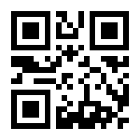
VERSION 3.1 – 001
Mark Here
Insert Receipt Here

Slide 3
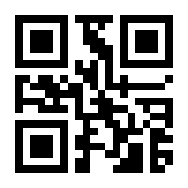
VERSION 3.0 – 002
Mark Here
Insert Receipt Here

Slide 4
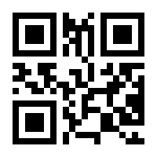
VERSION 3.0 – 003
Mark Here
Insert Receipt Here

Slide 5
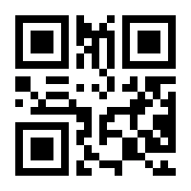
VERSION 3.0 – 004
Mark Here
Insert Receipt Here

Slide 6
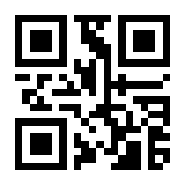
VERSION 3.0 – 005
Mark Here
Insert Receipt Here

Slide 7
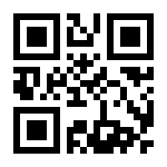
VERSION 3.0 – 006
Mark Here
Insert Receipt Here

Slide 8
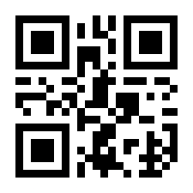
VERSION 3.0 – 007
Mark Here
Insert Receipt Here

Slide 9
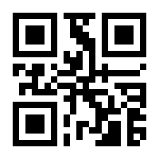
VERSION 3.0 – 008
Mark Here
Insert Receipt Here

Slide 10
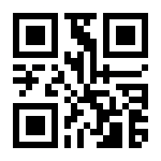
VERSION 3.0 – 009
Mark Here
Insert Receipt Here

Slide 11
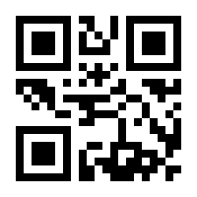
VERSION 3.0 – 010
Mark Here
Insert Receipt Here

Slide 12
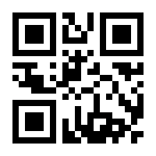
VERSION 3.0 – 011
Mark Here
Insert Receipt Here

Slide 13
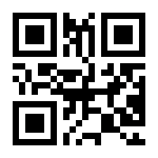
VERSION 3.0 – 012
Mark Here
Insert Receipt Here

Slide 14
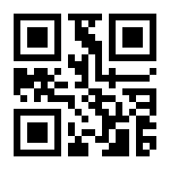
VERSION 3.0 – 013
Mark Here
Insert Receipt Here

Slide 15
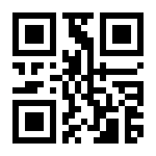
VERSION 3.0 – 014
Mark Here
Insert Receipt Here

Slide 16
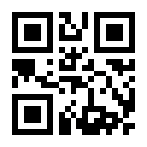
VERSION 3.0 – 015
Mark Here
Insert Receipt Here

Slide 17
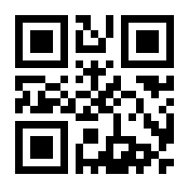
VERSION 3.0 – 016
Mark Here
Insert Receipt Here

Slide 18
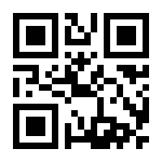
VERSION 3.0 – 017
Mark Here
Insert Receipt Here

Slide 19
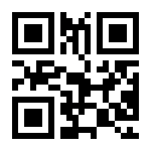
VERSION 3.0 – 018
Mark Here
Insert Receipt Here

Slide 20
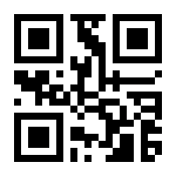
VERSION 3.0 – 019
Mark Here
Insert Receipt Here

Slide 21
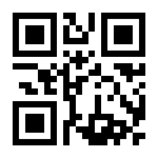
VERSION 3.0 – 020
Mark Here
Insert Receipt Here

Slide 22
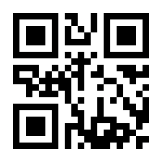
VERSION 3.0 – 021
Mark Here
Insert Receipt Here

Slide 23
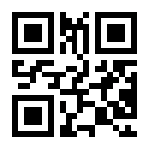
VERSION 3.0 – 022
Mark Here
Insert Receipt Here

Slide 24
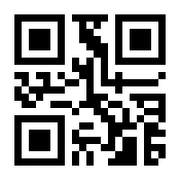
VERSION 3.0 – 023
Mark Here
Insert Receipt Here

Slide 25
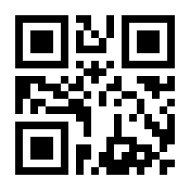
VERSION 3.0 – 024
Mark Here
Insert Receipt Here

Slide 26
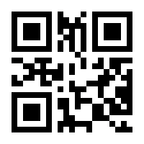
VERSION 3.0 – 025
Mark Here
Insert Receipt Here

Slide 27
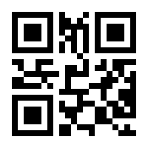
VERSION 3.0 – 026
Mark Here
Insert Receipt Here

Slide 28
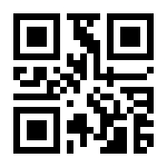
VERSION 3.0 – 027
Mark Here
Insert Receipt Here

Slide 29
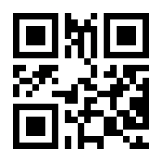
VERSION 3.0 – 028
Mark Here
Insert Receipt Here

Slide 30
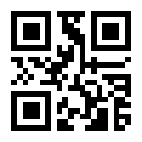
VERSION 3.0 – 029
Mark Here
Insert Receipt Here

Slide 31
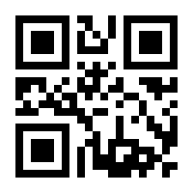
VERSION 3.0 – 030
Mark Here
Insert Receipt Here

Slide 32
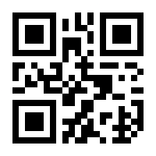
VERSION 3.0 – 031
Mark Here
Insert Receipt Here

Slide 33
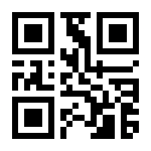
VERSION 3.0 – 032
Mark Here
Insert Receipt Here

Slide 34
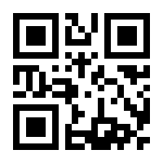
VERSION 3.0 – 033
Mark Here
Insert Receipt Here

Slide 35
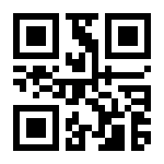
VERSION 3.0 – 034
Mark Here
Insert Receipt Here

Slide 36
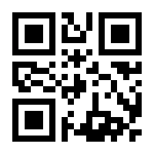
VERSION 3.0 – 035
Mark Here
Insert Receipt Here

Slide 37
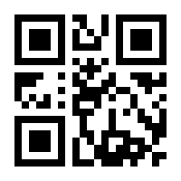
VERSION 3.0 – 036
Mark Here
Insert Receipt Here

Slide 38
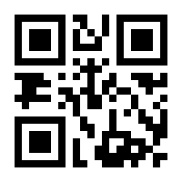
VERSION 3.0 – 037
Mark Here
Insert Receipt Here

Slide 39
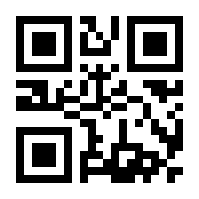
VERSION 3.0 – 038
Mark Here
Insert Receipt Here

Slide 40
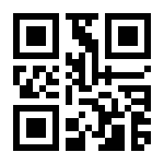
VERSION 3.0 – 039
Mark Here
Insert Receipt Here

Slide 41
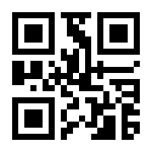
VERSION 3.0 – 040
Mark Here
Insert Receipt Here

Slide 42
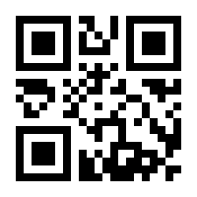
VERSION 3.0 – 041
Mark Here
Insert Receipt Here

Slide 43
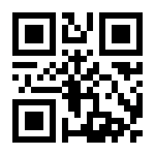
VERSION 3.0 – 042
Mark Here
Insert Receipt Here

Slide 44
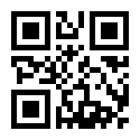
VERSION 3.0 – 043
Mark Here
Insert Receipt Here

Slide 45
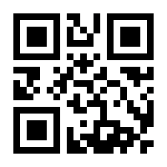
VERSION 3.0 – 044
Mark Here
Insert Receipt Here

Slide 46
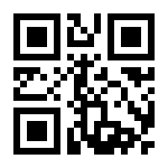
VERSION 3.0 – 045
Mark Here
Insert Receipt Here

Slide 47
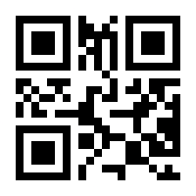
VERSION 3.0 – 046
Mark Here
Insert Receipt Here

Slide 48
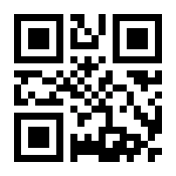
VERSION 3.0 – 047
Mark Here
Insert Receipt Here

Slide 49
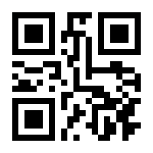
VERSION 3.0 – 048
Mark Here
Insert Receipt Here

Slide 50
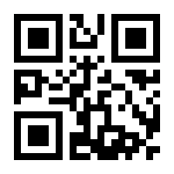
VERSION 3.0 – 049
Mark Here
Insert Receipt Here

Slide 51
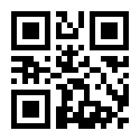
VERSION 3.0 – 050
Mark Here
Insert Receipt Here

Slide 52

VERSION 3.0 – 051
Mark Here
Insert Receipt Here

Slide 53

VERSION 3.0 – 052
Mark Here
Insert Receipt Here

Slide 54

VERSION 3.0 – 053
Mark Here
Insert Receipt Here

Slide 55

VERSION 3.0 – 054
Mark Here
Insert Receipt Here

Slide 56

VERSION 3.0 – 055
Mark Here
Insert Receipt Here

Slide 57

VERSION 3.0 – 056
Mark Here
Insert Receipt Here

Slide 58

VERSION 3.0 – 057
Mark Here
Insert Receipt Here

Slide 59

VERSION 3.0 – 058
Mark Here
Insert Receipt Here

Slide 60

VERSION 3.0 – 059
Mark Here
Insert Receipt Here

Slide 61

VERSION 3.0 – 060
Mark Here
Insert Receipt Here

Slide 62

VERSION 3.0 – 061
Mark Here
Insert Receipt Here

Slide 63

VERSION 3.0 – 062
Mark Here
Insert Receipt Here

Slide 64

VERSION 3.0 – 063
Mark Here
Insert Receipt Here

Slide 65

VERSION 3.0 – 064
Mark Here
Insert Receipt Here

Slide 66

VERSION 3.0 – 065
Mark Here
Insert Receipt Here

Slide 67

VERSION 3.0 – 066
Mark Here
Insert Receipt Here

Slide 68

VERSION 3.0 – 067
Mark Here
Insert Receipt Here

Slide 69

VERSION 3.0 – 068
Mark Here
Insert Receipt Here

Slide 70

VERSION 3.0 – 069
Mark Here
Insert Receipt Here

Slide 71

VERSION 3.0 – 070
Mark Here
Insert Receipt Here

Slide 72

VERSION 3.0 – 071
Mark Here
Insert Receipt Here

Slide 73

VERSION 3.0 – 072
Mark Here
Insert Receipt Here

Slide 74

VERSION 3.0 – 073
Mark Here
Insert Receipt Here

Slide 75

VERSION 3.0 – 074
Mark Here
Insert Receipt Here

Slide 76

VERSION 3.0 – 075
Mark Here
Insert Receipt Here

Slide 77

VERSION 3.0 – 076
Mark Here
Insert Receipt Here

Slide 78

VERSION 3.0 – 077
Mark Here
Insert Receipt Here

Slide 79

VERSION 3.0 – 078
Mark Here
Insert Receipt Here

Slide 80

VERSION 3.0 – 079
Mark Here
Insert Receipt Here

Slide 81

VERSION 3.0 – 080
Mark Here
Insert Receipt Here

Slide 82

VERSION 3.0 – 081
Mark Here
Insert Receipt Here

Slide 83

VERSION 3.0 – 082
Mark Here
Insert Receipt Here

Slide 84

VERSION 3.0 – 083
Mark Here
Insert Receipt Here

Slide 85

VERSION 3.0 – 084
Mark Here
Insert Receipt Here

Slide 86

VERSION 3.0 – 085
Mark Here
Insert Receipt Here

Slide 87

VERSION 3.0 – 086
Mark Here
Insert Receipt Here

Slide 88

VERSION 3.0 – 087
Mark Here
Insert Receipt Here

Slide 89

VERSION 3.0 – 088
Mark Here
Insert Receipt Here

Slide 90

VERSION 3.0 – 089
Mark Here
Insert Receipt Here

Slide 91

VERSION 3.0 – 090
Mark Here
Insert Receipt Here

Slide 92

VERSION 3.0 – 091
Mark Here
Insert Receipt Here

Slide 93

VERSION 3.0 – 092
Mark Here
Insert Receipt Here

Slide 94

VERSION 3.0 – 093
Mark Here
Insert Receipt Here

Slide 95

VERSION 3.0 – 094
Mark Here
Insert Receipt Here

Slide 96

VERSION 3.0 – 095
Mark Here
Insert Receipt Here

Slide 97

VERSION 3.0 – 096
Mark Here
Insert Receipt Here

Slide 98

VERSION 3.0 – 097
Mark Here
Insert Receipt Here

Slide 99

VERSION 3.0 – 098
Mark Here
Insert Receipt Here

Slide 100

VERSION 3.0 – 099
Mark Here
Insert Receipt Here

Slide 101

VERSION 3.0 – 100
Mark Here
Insert Receipt Here

Slide 102

VERSION 3.0 – 101
Mark Here
Insert Receipt Here

Slide 103

VERSION 3.0 – 102
Mark Here
Insert Receipt Here

Slide 104

VERSION 3.0 – 103
Mark Here
Insert Receipt Here

Slide 105

VERSION 3.0 – 104
Mark Here
Insert Receipt Here

Slide 106

VERSION 3.0 – 105
Mark Here
Insert Receipt Here

Slide 107

VERSION 3.0 – 106
Mark Here
Insert Receipt Here

Slide 108

VERSION 3.0 – 107
Mark Here
Insert Receipt Here

Slide 109

VERSION 3.0 – 108
Mark Here
Insert Receipt Here

Slide 110

VERSION 3.0 – 109
Mark Here
Insert Receipt Here

Slide 111

VERSION 3.0 – 110
Mark Here
Insert Receipt Here

Slide 112

VERSION 3.0 – 111
Mark Here
Insert Receipt Here

Slide 113

VERSION 3.0 – 112
Mark Here
Insert Receipt Here

Slide 114

VERSION 3.0 – 113
Mark Here
Insert Receipt Here

Slide 115

VERSION 3.0 – 114
Mark Here
Insert Receipt Here

Slide 116

VERSION 3.0 – 115
Mark Here
Insert Receipt Here

Slide 117

VERSION 3.0 – 116
Mark Here
Insert Receipt Here

Slide 118

VERSION 3.0 – 117
Mark Here
Insert Receipt Here

Slide 119

VERSION 3.0 – 118
Mark Here
Insert Receipt Here

Slide 120

VERSION 3.0 – 119
Mark Here
Insert Receipt Here

Slide 121

VERSION 3.0 – 120
Mark Here
Insert Receipt Here

Slide 122

VERSION 3.0 – 121
Mark Here
Insert Receipt Here

Slide 123

VERSION 3.0 – 122
Mark Here
Insert Receipt Here

Slide 124

VERSION 3.0 – 123
Mark Here
Insert Receipt Here

Slide 125

VERSION 3.0 – 124
Mark Here
Insert Receipt Here

Slide 126

VERSION 3.0 – 125
Mark Here
Insert Receipt Here

Slide 127

VERSION 3.0 – 126
Mark Here
Insert Receipt Here

Slide 128

VERSION 3.0 – 127
Mark Here
Insert Receipt Here

Slide 129

VERSION 3.0 – 128
Mark Here
Insert Receipt Here

Slide 130

VERSION 3.0 – 129
Mark Here
Insert Receipt Here

Slide 131

VERSION 3.0 – 130
Mark Here
Insert Receipt Here

Slide 132

VERSION 3.0 – 131
Mark Here
Insert Receipt Here

Slide 133

VERSION 3.0 – 132
Mark Here
Insert Receipt Here

Slide 134

VERSION 3.0 – 133
Mark Here
Insert Receipt Here

Slide 135

VERSION 3.0 – 134
Mark Here
Insert Receipt Here

Slide 136

VERSION 3.0 – 135
Mark Here
Insert Receipt Here

Slide 137

VERSION 3.0 – 136
Mark Here
Insert Receipt Here

Slide 138

VERSION 3.0 – 137
Mark Here
Insert Receipt Here

Slide 139

VERSION 3.0 – 138
Mark Here
Insert Receipt Here

Slide 140

VERSION 3.0 – 139
Mark Here
Insert Receipt Here

Slide 141

VERSION 3.0 – 140
Mark Here
Insert Receipt Here

Slide 142

VERSION 3.0 – 141
Mark Here
Insert Receipt Here

Slide 143

VERSION 3.0 – 142
Mark Here
Insert Receipt Here

Slide 144

VERSION 3.0 – 143
Mark Here
Insert Receipt Here

Slide 145

VERSION 3.0 – 144
Mark Here
Insert Receipt Here

Slide 146

VERSION 3.0 – 145
Mark Here
Insert Receipt Here

Slide 147

VERSION 3.0 – 146
Mark Here
Insert Receipt Here

Slide 148

VERSION 3.0 – 147
Mark Here
Insert Receipt Here

Slide 149

VERSION 3.0 – 148
Mark Here
Insert Receipt Here

Slide 150

VERSION 3.0 – 149
Mark Here
Insert Receipt Here

Slide 151

VERSION 3.0 – 150
Mark Here
Insert Receipt Here

